Slide 1
Racism as a System of Exclusion:
Race, Racism, and Structures of Oppression
J. Spenser Darden, M.A.
He/Him/His | They/Them/Theirs
Division of Diversity, Equity and Inclusion
West Virginia University

Slide 2
Today’s Reflection
“‘Courage is not the absence of fear, but the strength to do what is right in the face of it,’ as the anonymous philosopher tells us. Some of us are restrained by fear of what could happen to us if we resist. In our naivete, we are less fearful of what could happen to us -- or is already happening to us-- if we don't resist.”
(How to be an anti-racist; Ibram X. Kendi)
Division of Diversity, Equity, and Inclusion

Slide 3
Today’s Discussion...
...is not a “lecture”
My hope is to facilitate dialogue and reflection, and develop a sense of urgency and ownership over addressing and dismantling racism
Main topics include
Power, Priviledge, and C/Overt Oppression
Racism as a social construct
Division of Diversity, Equity, and Inclusion

Slide 4
Social Norms
Social norms, like many other social phenomena, are the unplanned result of individuals’ interaction. It has been argued that social norms ought to be understood as a kind of grammar … [that] specifies what is acceptable and what is not in a society or group.
Who sets the norms?
Who benefits from them?
Why are they so universally adopted?
What are the penalties for not adhering to these norms?
https://plato.stanford.edu/entries/social-norms/

Slide 5
Bringing In Power
Power - the ability to do something or act in a particular way
Two Types
Individual & Institutional
Individual Power
The ability to access and influence resources, systems, structures, and individuals
Institutional Power
Power wielded by entities like governments, churches, and corporations to control people and direct their behavior through the use of rewards and punishments (Socially Approved & Accepted as Legitimate)
https://courses.lumenlearning.com/boundless-sociology/

Slide 7
On One Side...
Those with power (or who hold identities similar to those in power) experience privilege
Privilege
Unearned, unasked for, often invisible benefits and advantages only readily available to dominant groups
Privilege DOESN’T mean Wealth
A right or immunity granted as a particular benefit, advantage, or favor
ONLY held by certain identities
https://ombuds.web.cern.ch/blog/2017/09/unearned-advantage

Slide 8
...On the Other Side
Power (For / Against) + Privilege =
Oppression
The systemic devaluation…marginalization, and disadvantaging of certain social identities; the denial of some people things of value while others are given ready access​
Examples of Power (For) + Privilege
Legacy admissions; Nepotism in hiring; “Image rehabilitation”
Examples of Power (Against) + Privilege
Tendency to think in terms of physical oppression (i.e. slavery/the Holocaust), but many are nearly invisible​
https://www.racialequitytools.org/home

Slide 9
From Overt to Covert

Slide 10
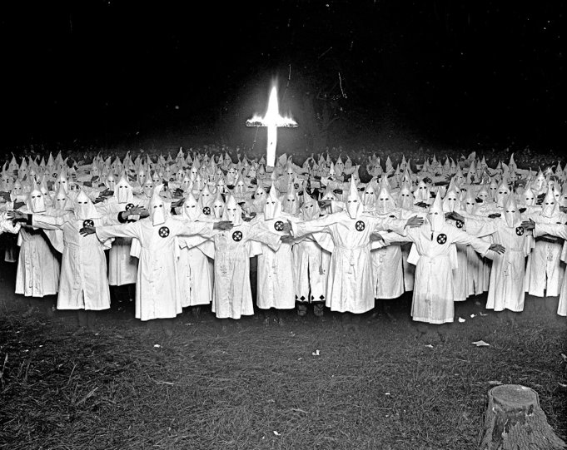
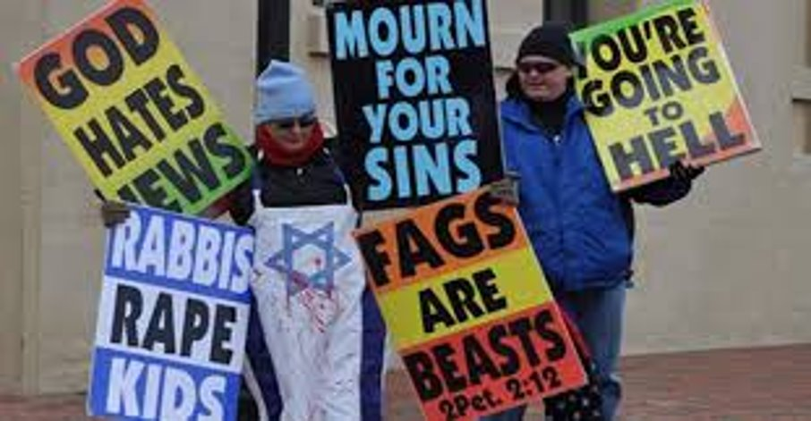
Overt Oppression
Open and observable, not secret or hidden. The target of overt oppression is very aware of the intention and action of the oppressive act, and of the oppressive person or group.
https://www.racialequitytools.org/home

Slide 11
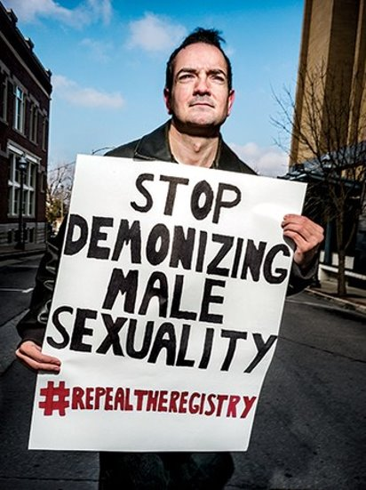
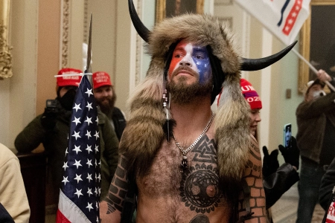
Overt Oppression
Open and observable, not secret or hidden. The target of overt oppression is very aware of the intention and action of the oppressive act, and of the oppressive person or group.
https://www.racialequitytools.org/home

Slide 12
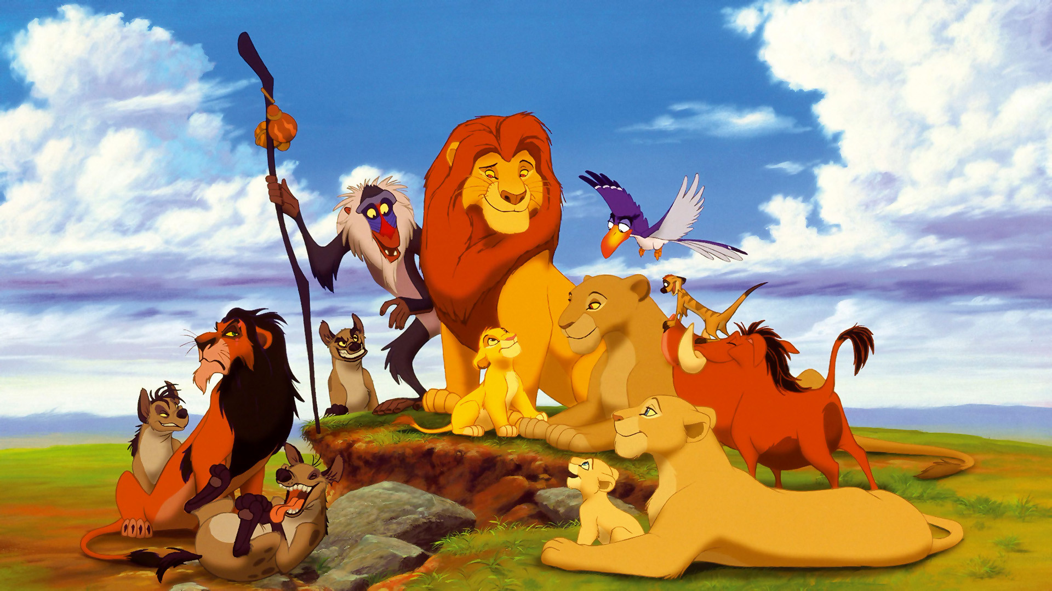
Covert Oppression
Secret, hidden and not openly practiced, or so subtle that they are not readily obvious, even to the intended target. The person targeted with covert oppression may not even realize that an oppressive act has occurred
https://www.racialequitytools.org/home

Slide 13
Why?

Slide 14
An Important Shift
Overt oppression (racism, sexism) - in many instances - has been made illegal
Therefore, it has become less socially acceptable
American Exceptionalism
Emergence of the “melting pot” narrative - assimilation
Myth of Meritocracy
Self-serving bias
“But, I’m a good person”
https://www.dailykos.com/stories/2015/6/19/1394875/-Are-you-a-racist-Overt-vs-covert-racism

Slide 15
Understanding Race
& Racism

Slide 16
Myths About Race & Racism
Often conceptualized of as individual acts
“Evil”
Talking about race perpetuates racism
Being called racist is offensive
Not seeing race is the goal
What else?

Slide 17
The Social Significance
of Race

Slide 18
An Important Note...
The British Colonizers did not invent the concept of race, or categorization based upon human difference
However, “When Europeans did use the term ‘race’ it was employed to talk about tribal groups, such as the ‘Teutonic races’ and while those categories might have been used as indicators of ‘types’ they were by no means seen as limiting or indicative of innate inferiority.”
“But did anyone think they were “white” or that their character related to their color? No, for neither the idea of race nor the idea of “white” people had been invented, and people’s skin color did not carry useful meaning.” (Painter, 2010)
https://timeline.com/europeans-invented-the-concept-of-race-as-we-know-it-58f896fae625

Slide 19
15th Century Context
Nation-states did not exist as they do today
“...there was no concept of being “Italian,” for instance. People identified with regional areas, as Calabrese, Genoan, etc.”
Most important divisions
Class (S.E.S)
Religion
https://timeline.com/europeans-invented-the-concept-of-race-as-we-know-it-58f896fae625

Slide 20
Complicating Factors
Indentured Servants
“With its rapidly increasing population, religious and royal wars, Irish ethnic cleansing, and fear of rising crime, Britain excelled among the European imperial powers in shipping its people into bondage in distant lands...bound Britons, Scots, and Irish furnished a crucial workforce...sold into field labor for twenty pounds of tobacco each.” (Painter, 2010)
Involuntary - 1619 (100 children; 25 girls)
Voluntary - 1627

Slide 21
Us and Them
Indentured Servants
“Before the eighteenth-century boom in the African slave trade, between one-half and two-thirds of all early white immigrants came as unfree laborers, some 300,000 to 400,000 people.” (p. 42)
Bacon’s Rebellion - 1676

Slide 22
Bacon’s Rebellion - 1676-77
Armed rebellion led by wealthy property owner Nathaniel Bacon - organized indentured servants & enslaved people
Purpose: the overthrow of VA Governor - highest ranking official in the Colonies
Attacked the Doeg & Susquehannock tribes
After the militia captured and destroyed Jamestown, the rebellion was put down by merchant ship captains and British military forces
https://www.facinghistory.org/holocaust-and-human-behavior/chapter-2/inventing-black-and-white

Slide 23
The Outcome
Natives/Africans identified as the “enemy Other”
Fear of class solidarity
Remember; “Us” vs. “Them”
Europeans awarded privileges over Indentured Servants of Color and African slaves**
Earned freedom
Legal enslavement of Natives
Use-of-force (i.e. whipping)
Property confiscated & sold to benefit poor Europeans
https://www.facinghistory.org/holocaust-and-human-behavior/chapter-2/inventing-black-and-white

Slide 24
A New “Us”
By this point, ~2-3 generations removed from being European
1619-1676 (57 years)
Life expectancy ~ 40 years
Important to remember: These labels are developed to define and describe the ways people have access to societal benefits
https://msuweb.montclair.edu/~furrg/spl/thandekawhiting.html

Slide 25
European
Christian

Slide 26
The Problem with “Christian”
Case Study: Elizabeth Key
Born in 1630 - VA
Father - White Planter (Thomas Key)
Mother - Enslaved African Woman
Placed in indentured servitude (transferred to John Mottrom - Justice of the Peace)
1655 - Mottrom died; Key & son designated as “enslaved”
Key sued for her & her son’s freedom
Father was English & free (ECL - status followed the father)
Was indentured longer than supposed to be
Baptized and practicing Christian
https://www.zinnedproject.org/news/tdih/elizabeth-key-wins-freedom/

Slide 27
The Result
1667
VA General Assembly - “conferring of baptism does not alter the condition of the person as to his bondage or freedom.”
New laws - the status of the child derived from the mother
https://www.zinnedproject.org/news/tdih/elizabeth-key-wins-freedom/

Slide 28
Christian
European
White

Slide 29
“Many of the European-descended poor whites began to identify themselves, if not directly with the rich whites, certainly with being white. And here you get the emergence of this idea of a white race as a way to distinguish themselves from those dark-skinned people who they associate with perpetual slavery.”
Race: The Power of an Illusion, Ep. 2
(Kelley, 2003)

Slide 30
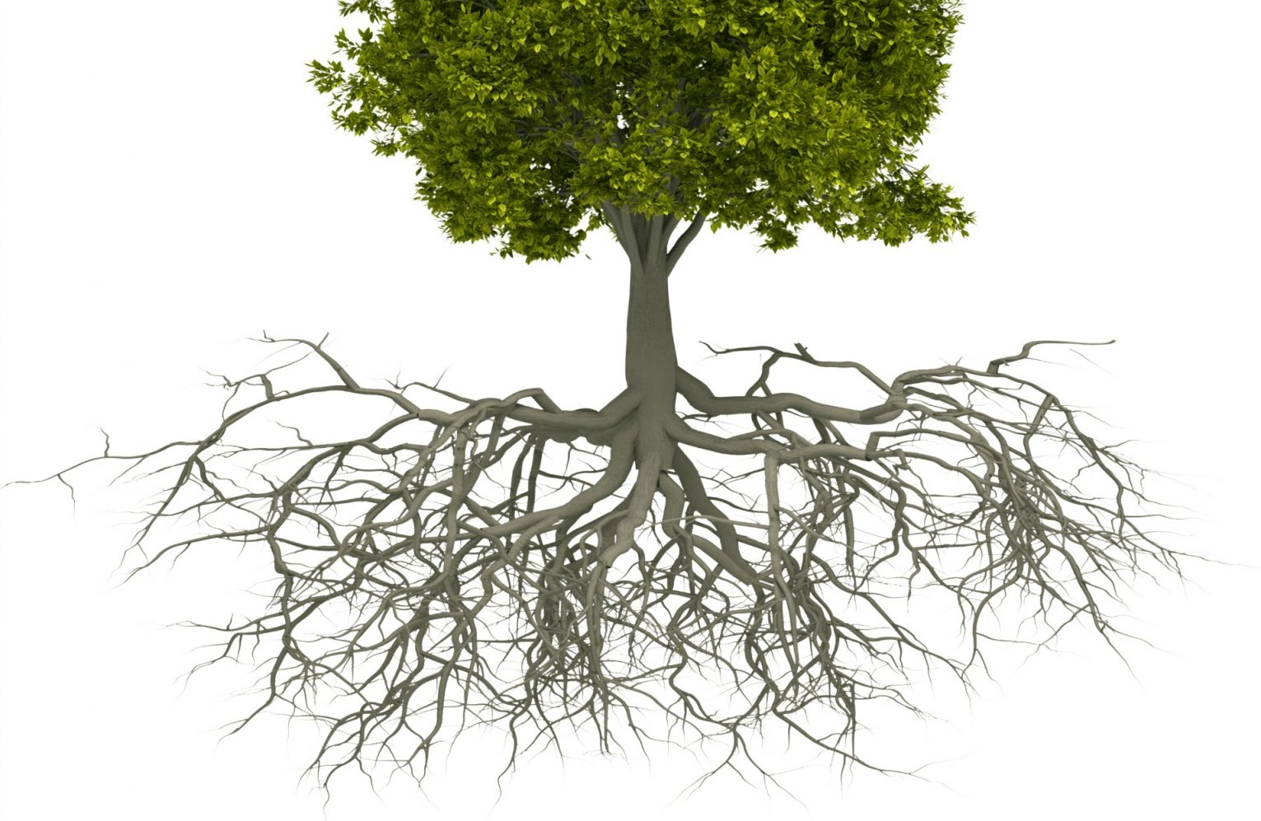
United States of America
Racist Ideas
Employment
Housing
Policing
Healthcare
Legal System
Religion
Wealth
Education
Capitalism
Music, Arts, & Theatre

Slide 31
Zooming In On:
Morgantown

Slide 32
Final Thoughts & Questions
Division of Diversity, Equity, and Inclusion

Slide 33
Thank You!
J. Spenser Darden
Director
Diversity Initiatives & Community Engagement
Division of Diversity, Equity and Inclusion
West Virginia University
jdarden@mail.wvu.edu

